Slide 1
CS 211 Computer Architecture Lecture 42: Input Output Systems – Part 1 Introduction, Polling, Interrupt driven I/O
Ravi Mittal
ravi.mittal@iitgoa.ac.in
Indian Institute of Technology, Goa

Slide 2
Acknowledgements
Contents of this presentation has been taken from various sources. Would like to thank original contributors
Course 61c, Great Ideas in Computer Architecture, University of California, Berkeley, lecture Input/Output, Instructor Branden Ghena, 2019
Morgan Rae Reschenberg, CS 61C: Great Ideas in Computer Architecture (Machine Structures), http://inst.eecs.berkeley.edu/~cs61c/
Lecture Slides on I/O, course CS 3410, Prof Hakim Weatherspoon, Cornell University
Chapter 7, Input/Output, Computer Organization, William Stallings
Book: Computer Systems: A programmer’s perspective, Randal E. Bryant and David R. O’Hallaron

Slide 3
We will study today ..
I/O Devices: An Introduction
I/O Devices: Architectures
Memory Mapped I/O: Polling
Memory Mapped I/O: Interrupt

Slide 4
Input Output Devices: An Introduction

Slide 5
Five Components of a Computer
Components a computer needs to work
Control
Datapath
Memory
Input
Output
Computer
Processor
Memory
Devices
Control
Input
Datapath
Output
Ref: Morgan Rae Reschenberg, Course 61C, Univ of California, Berkeley

Slide 6
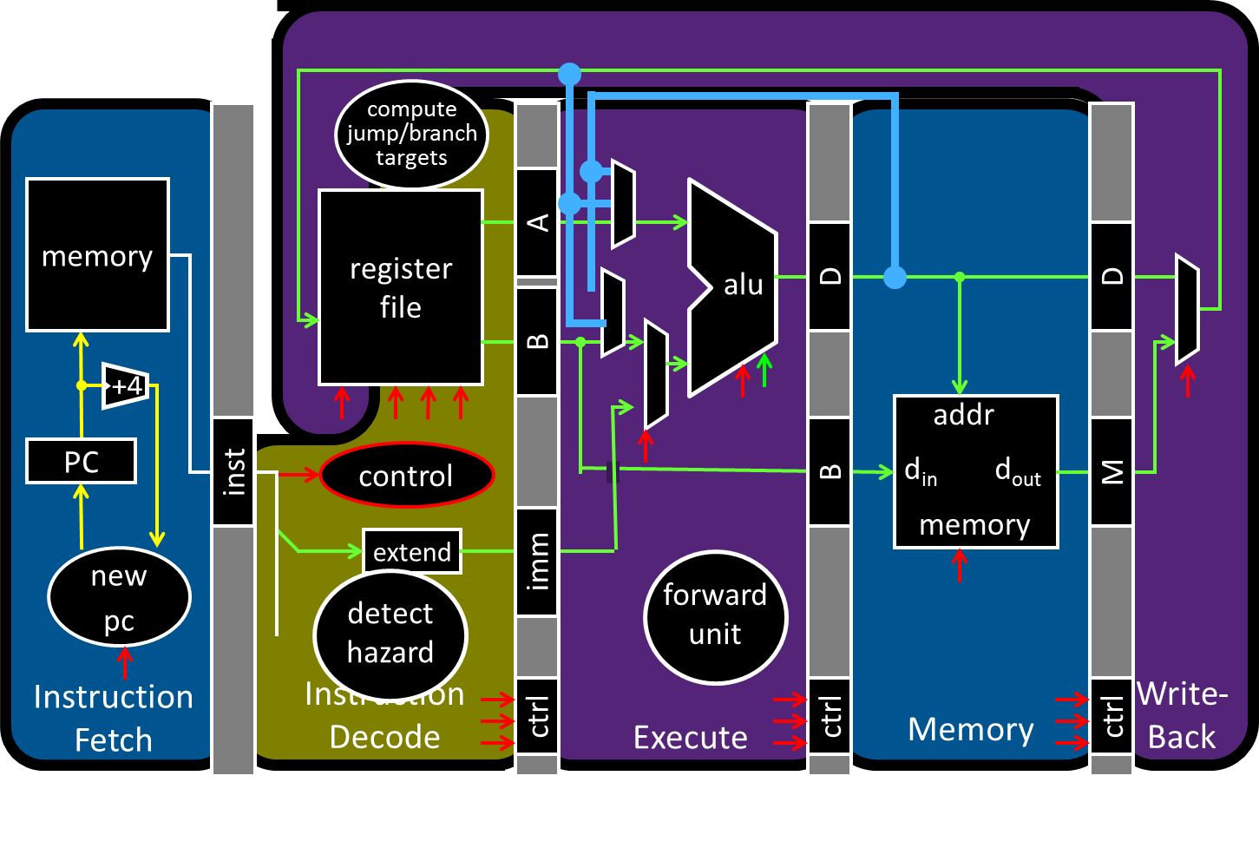
Big Picture: Input/Output (I/O)
Ref: I/O lecture, Prof Hakim Weatherspoon, Cornell Univ
How does a processor interact with its environment?

Slide 7
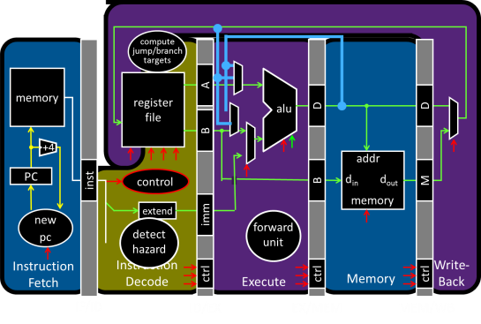
Big Picture: Input/Output (I/O)
How does a processor interact with its environment?
Computer System =
Memory + Datapath + Control
+ Input + Output
Keyboard
Network
Disk
Display
Ref: I/O lecture, Prof Hakim Weatherspoon, Cornell Univ

Slide 8
The importance of I/O
I/O handles persistent storage
Disks, SSD memory, etc
I/O handles user interfaces
Keyboard, mouse, display
I/O handles network

Slide 9
Mouse
I got the idea for the mouse while attending a talk at a computer conference. The speaker was so boring that I started daydreaming and hit upon the idea.
Doug Englebart

Slide 10
Input Output Devices for Daily use
Laptop
Keyboard, Mouse, touch pad, Screen, USB ports, Ethernet, WiFi, Bluetooth, Speakers, GPS sensors, heat sensors etc
Ipad
Touch Screen, WiFi, Bluetooth, USB port, Various sensors
Mobile
WiFi Router
TV
Digital Camera
Mouse

Slide 11
Inputs have many forms
Keyboard and mouse (USB)
Touch screen
Audio input
Camera
Motion
Fingerprint sensor

Slide 12
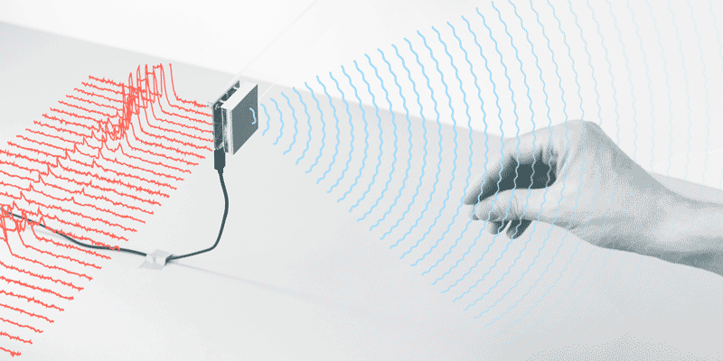
Inputs have many forms
Tiny Radar (Pixel 4)
Ref: CS 61C, Lecture on Input/Output, Branden Ghena, Univ of California, Berkeley
Notes:
Google introduced the revolutionary “Motion Sense” technology on the Google Pixel 4 devices.

Slide 13
Outputs have many forms too
Displays
Audio output
Printers
LEDs
RFID Reader
Ref: CS 61C, Lecture on Input/Output, Branden Ghena, Univ of California, Berkeley

Slide 14
General-Purpose Computer
Input Output
Mouse
Monitor
Computer
Keyboard
Headphones
Ethernet
Ethernet
Bluetooth
Bluetooth
Ref: CS 61C, Lecture on Input/Output, Branden Ghena, Univ of California, Berkeley

Slide 15
Cyber-Physical System
Ref: CS 61C, Lecture on Input/Output, Branden Ghena, Univ of California, Berkeley
Input Output
Lidar
Throttle Control
Computer
Inertial Measurement Unit
Brake Control
Camera
Wheel Rotation
CAN
CAN
CAN: Controller Area Network
Notes:
Lidar: Light Detection and Ranging: It uses lasers to ping off objects and return to the source of the laser, measuring distance by timing the travel, or flight, of the light pulse.
An inertial measurement unit (IMU) is an electronic device that measures and reports a body's specific force, angular rate, and sometimes the orientation of the body, using a combination of accelerometers, gyroscopes, and sometimes magnetometers.
CAN: Controller Area Network (CAN) is a serial network technology that was originally designed for the automotive industry, especially for European cars, but has also become a popular bus in industrial automation as well as other applications.

Slide 16
Computers without Input or Output?
Imagine a laptop
Without a screen
Without a keyboard or touchpad
Without WiFi or Ethernet
Without USB ports
What is it good for?
A computer without I/O is like a car without wheels
Interesting technology, but gets you nowhere
Ref: CS 61C, Lecture on Input/Output, Branden Ghena, Univ of California, Berkeley

Slide 17
I/O Device Examples and Speeds
I/O speeds: 8 orders of magnitude between keyboard and graphics
Device | Behavior | Partner | Data Rate (Kb/s)
Keyboard | Input | Human | 0.2
Mouse | Input | Human | 0.4
Microphone | Input | Human | 700.0
Bluetooth | Input or Output | Machine | 20,000.0
Hard disk drive | Storage | Machine | 100,000.0
Wireless network | Input or Output | Machine | 300,000.0
Solid state drive | Storage | Machine | 500,000.0
Wired LAN network | Input or Output | Machine | 1,000,000.0
Graphics display | Output | Human | 3,000,000.0
→ System should efficiently handle varying speed I/O devices
Ref: CS 61C, Lecture on Input/Output, Branden Ghena, Univ of California, Berkeley
Notes:
keyboard - 1~30*8 byte per secondhttps://www.quora.com/What-amount-of-data-is-transferred-between-a-mouse-and-a-laptop-when-they%E2%80%99re-connected-via-USB
mouse - ~400 byte per second https://www.howtogeek.com/193866/are-there-any-benefits-from-plugging-your-mouse-into-a-usb-3.0-port/ microphone - 44.1 kHz * 16 bit audio
disks - https://www.storagereview.com/ssd_vs_hdd

Slide 18
Disk Storage and SSD (Self Reading)

Slide 19
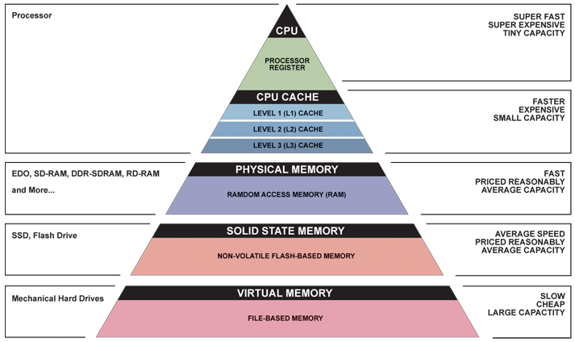
Great Idea: Principle of Locality/ Memory Hierarchy
Registers
Primary
Memory
Hard Disk Drives

Slide 20
Disk: I/O or Memory?
What qualities might make them one or the other?
A | B | C | D | E
Disks are I/O | Disks are Memory | I don’t know
Ref: CS 61C, Lecture on Input/Output, Branden Ghena, Univ of California, Berkeley

Slide 21
Disks are I/O
DISK
Process A
Process B
Process A
RAM
Process C
CPU
Process B
Process C
Disk is never accessed as memory
Pages are loaded from disk into RAM
Ref: CS 61C, Lecture on Input/Output, Branden Ghena, Univ of California, Berkeley

Slide 22
Disks (self reading)
Nonvolatile storage
Retains its value without power
Long-term, inexpensive storage for files
Two Types:
Magnetic Drives (Mechanical Drive and Floppy Disk)
Information stored by magnetizing ferrite material on surface of rotating disk
Flash Drives (Solid State Drives and Thumb Drives)
Information stored by trapping charge in a semiconductor and MOSFET based dual-gate transistor
Ref: CS 61C, Lecture on Input/Output, Branden Ghena, Univ of California, Berkeley

Slide 23
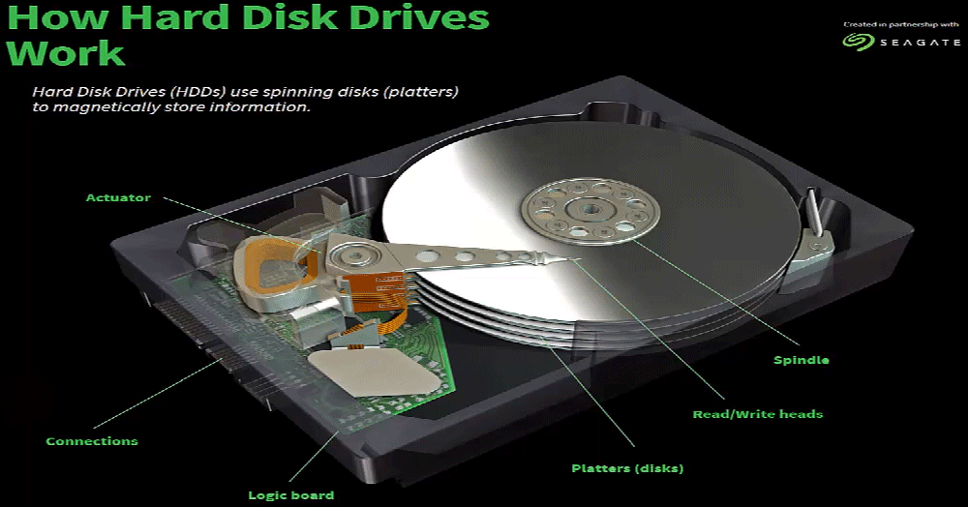
Hard Drive in Action (self reading)
Ref: CS 61C, Lecture on Input/Output, Branden Ghena, Univ of California, Berkeley

Slide 24
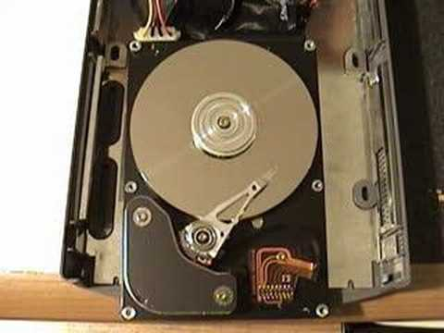
Video of a HDD (self reading)
Video of hard disk in action

Slide 25
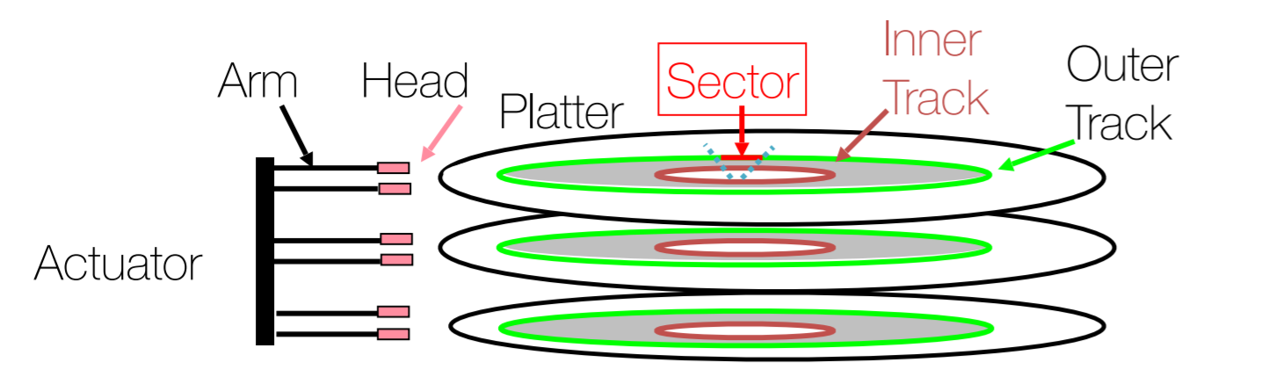
Several platters with information recorded magnetically on both surfaces (usually)
Bits recorded in tracks, which in turn are divided into sectors (usually 4 kB)
Sector 0
Sector 1
Sector 2
Track 3
Track 3
Ref: CS 61C, Lecture on Input/Output, Branden Ghena, Univ of California, Berkeley
Notes:
Average Rotation Time = time for 1/2 a rotation
Transfer Time = size of data request / transfer rate

Slide 26
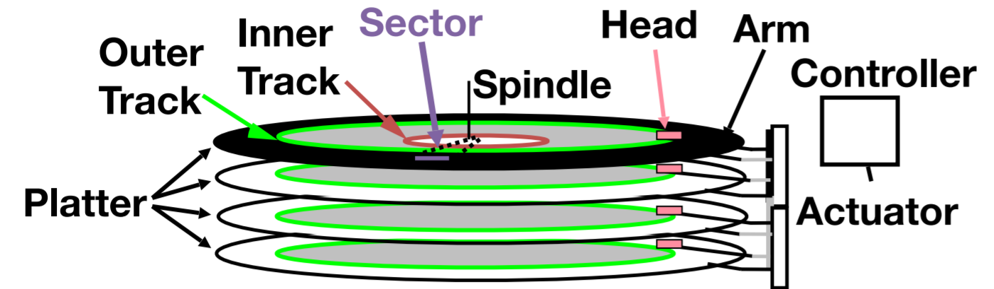
Reading and writing from the disk:
Actuator moves head (end of arm) over track (“seek”), wait for sector to rotate under head, then read or write
Disk Access Time =
Seek Time + Rotation Time + Transfer Time + Controller Overhead
Seek Time - time to position head to correct track
Rotation Time - time for disk to rotate to proper sector
Transfer Time - time for data to rotate under the head
Notes:
Average Rotation Time = time for 1/2 a rotation
Transfer Time = size of data request / transfer rate

Slide 27
Disk Device Performance (self reading)
To find performance, we can estimate some values
Rotation Time: Average distance of sector from head?
Average rotation time = 1/2 time of a rotation
7200 Revolutions Per Minute ⇒ 120 Rev/sec
1 revolution = 1/120 sec ⇒ 8.33 milliseconds
1/2 rotation (revolution) ⇒ 4.17 ms ~16,000,000 instructions...
Seek time: Average number of tracks to move arm?
Number of tracks/3 (see CS186 for the math)
Average seek time = average number of tracks moved × time to move across one track
Ref: CS 61C, Lecture on Input/Output, Branden Ghena, Univ of California, Berkeley

Slide 28
Faster Hard Drives (self reading)
Many disks have on-disk caches (totally hidden from the rest of the computer)
L1 cache -> L2 cache -> L3 cache -> RAM -> Disk Cache -> Disk
Ref: CS 61C, Lecture on Input/Output, Branden Ghena, Univ of California, Berkeley

Slide 29
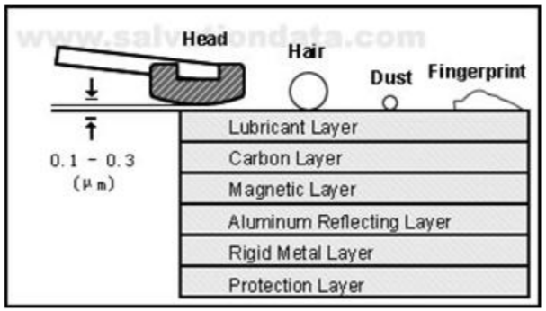
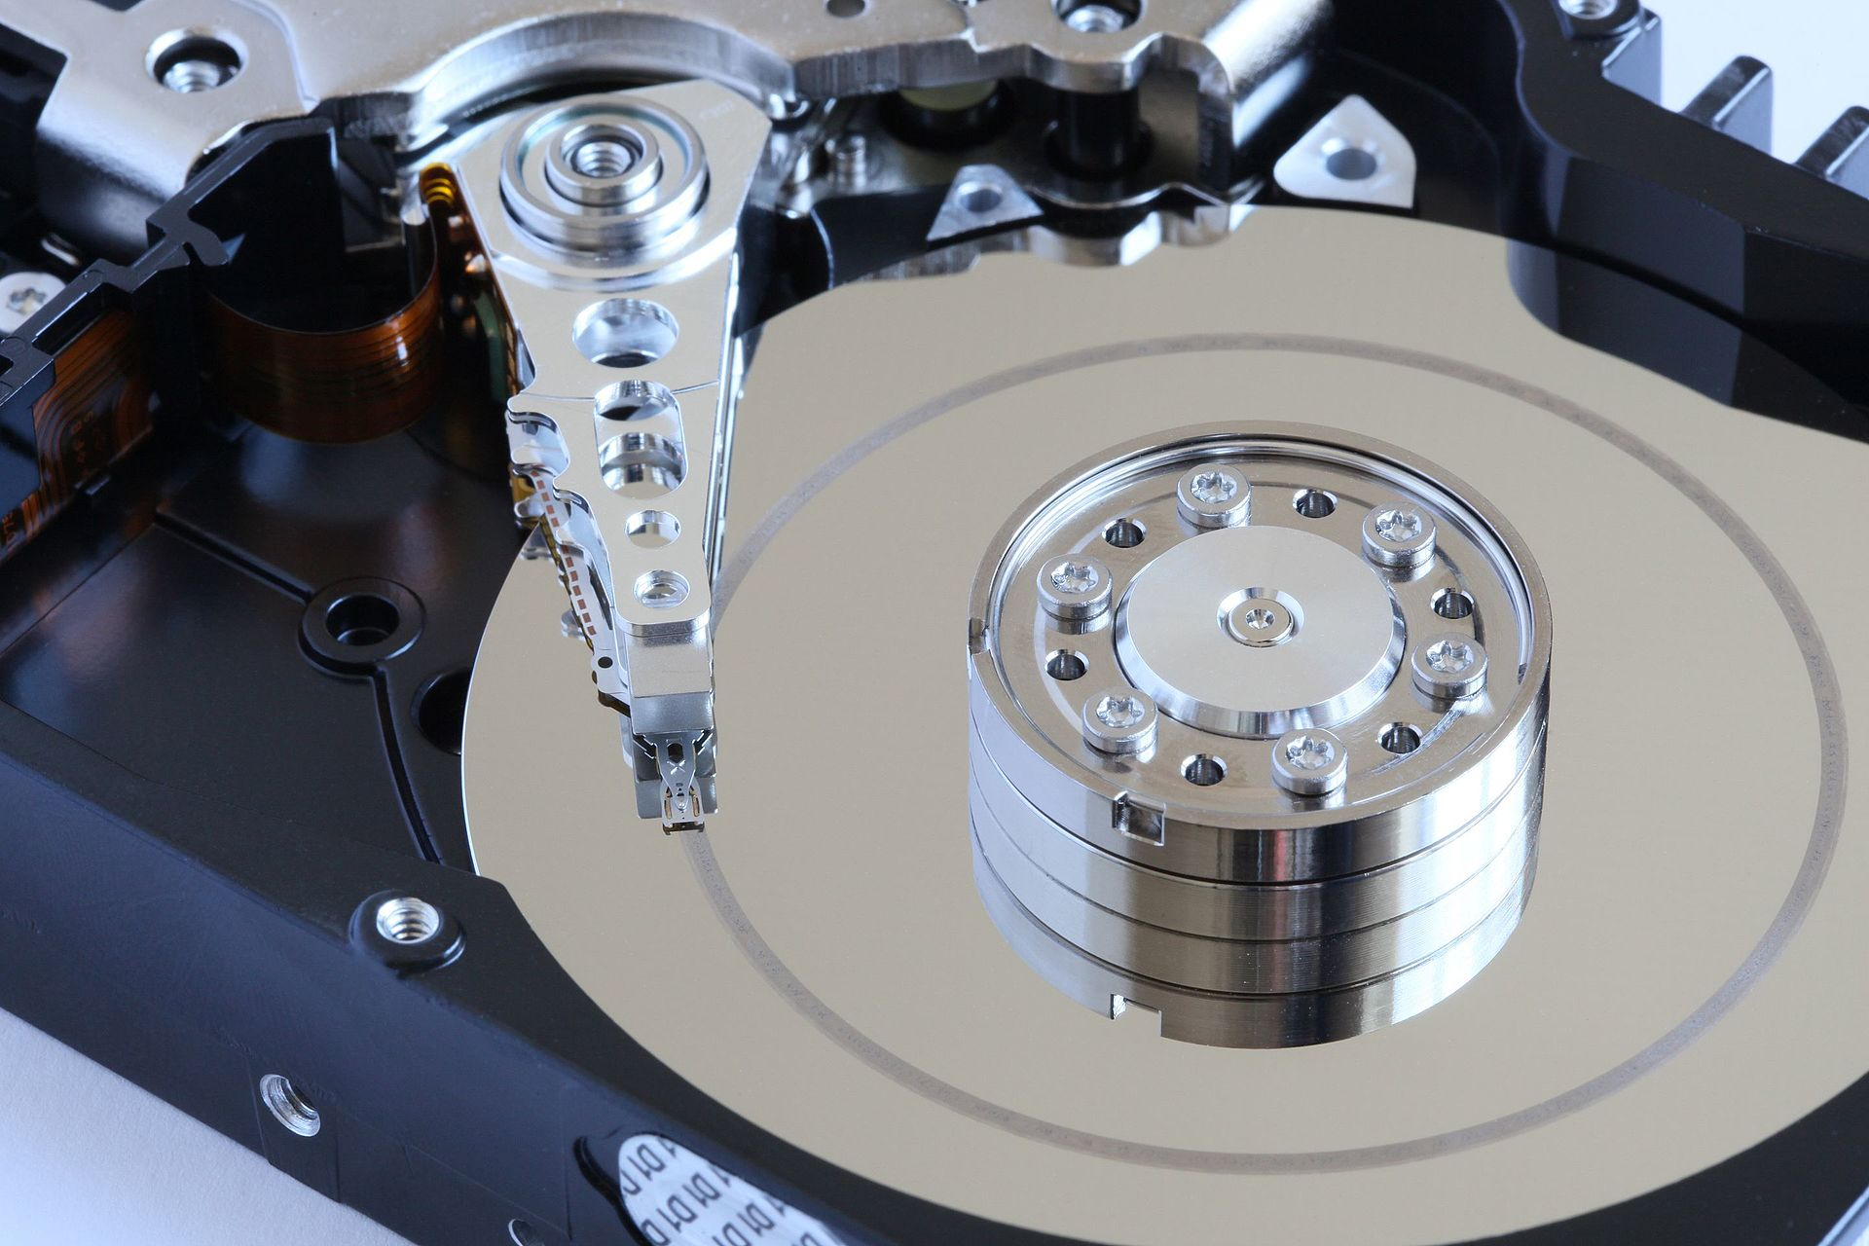
HDD Difficulties
Fast-spinning disk with moving armatures. What could go wrong?
Head Crash
Literally the head hitting into the disk surface
Ref: CS 61C, Lecture on Input/Output, Branden Ghena, Univ of California, Berkeley

Slide 30
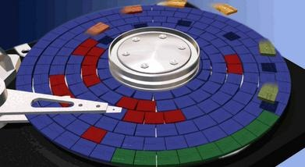
Fragmentation
To spend less seek and rotation time, we want data to be contiguous whenever possible
Fragmentation occurs when files are not stored contiguously on the disk
Ref: CS 61C, Lecture on Input/Output, Branden Ghena, Univ of California, Berkeley

Slide 31
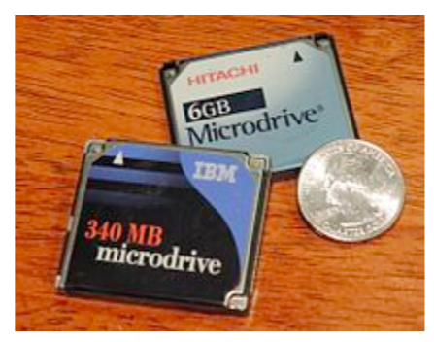
What about Solid State Drives?
~10 years ago: Microdrives and Flash memory (e.g., CompactFlash) went head-to-head
Both non-volatile (retains contents without power supply)
Flash benefits: lower power, no crashes (no moving parts, need to spin µdrives up/down)
Disk cost = fixed cost of motor + arm mechanics, but actual magnetic media cost very low
Flash cost = most cost/bit of flash chips
Cost/bit of flash came down, became cost competitive for dense storage
Ref: CS 61C, Lecture on Input/Output, Branden Ghena, Univ of California, Berkeley

Slide 32
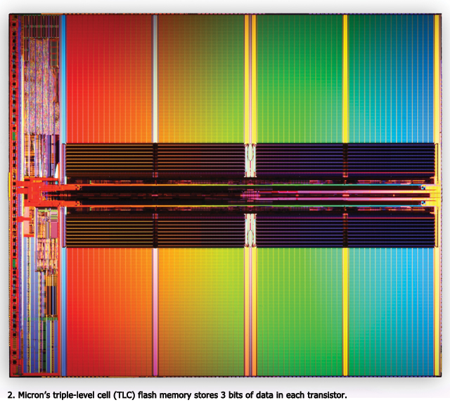
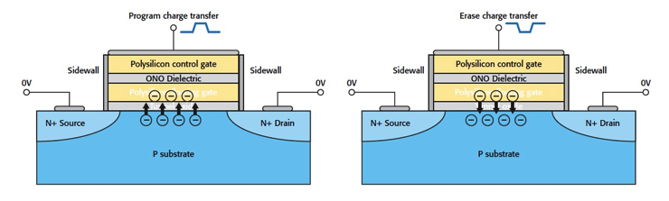
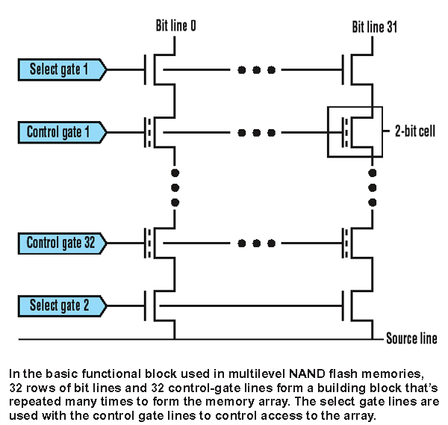
Flash Memory / SSD Technology
NMOS transistor with an additional conductor between gate and source/drain which “traps” electrons. The presence/absence is a 1 or 0

Slide 33
Flash Memory Problems
Flash has a limited number of program-erase cycles
10,000 - 100,000 writes total…
Solutions:
Apply wear leveling to distribute writes evenly
Move frequently written data around
Create a map from addresses to real locations
Lie about how much space you have
Sell a 100 GB SSD that secretly has 120 GB
Slowly move memory over as sections die
Ref: CS 61C, Lecture on Input/Output, Branden Ghena, Univ of California, Berkeley

Slide 34
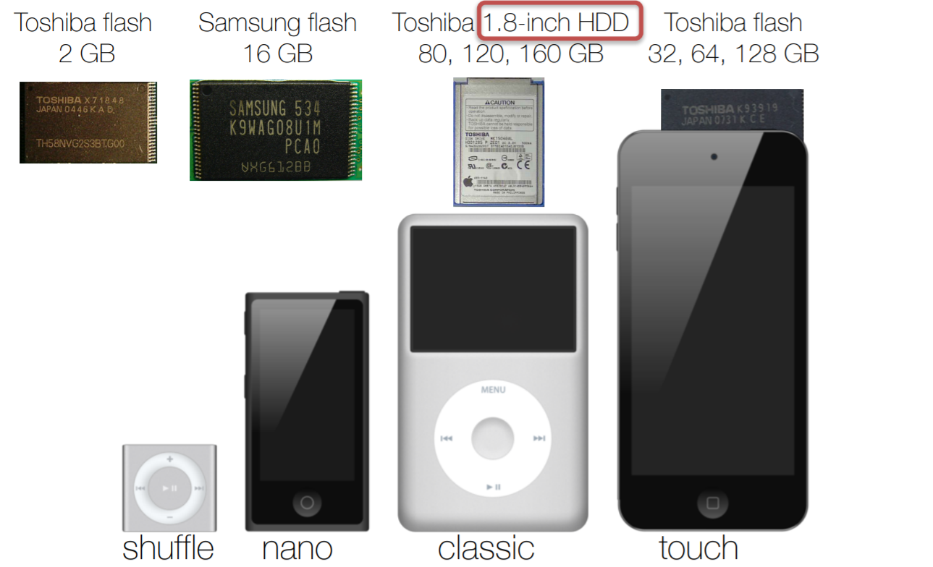
Original iPods
Ref: CS 61C, Lecture on Input/Output, Branden Ghena, Univ of California, Berkeley

Slide 35
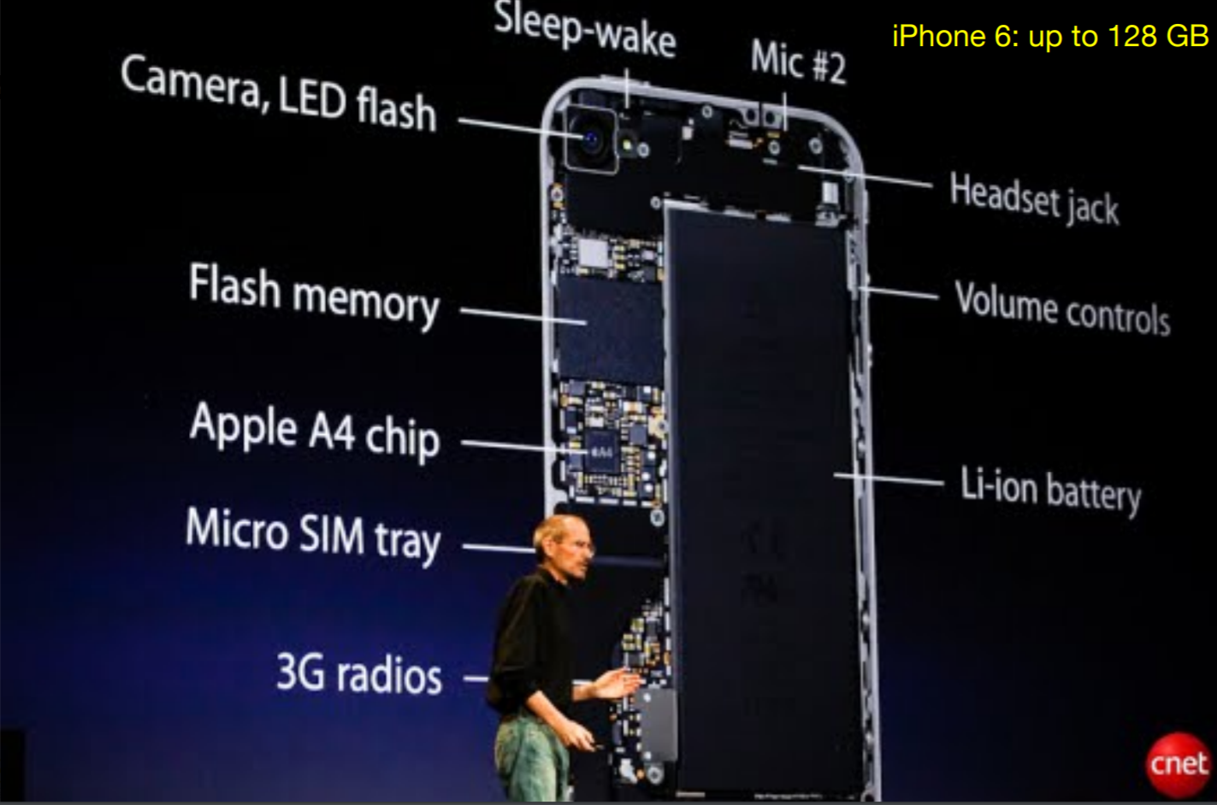
Smartphones Use Flash Memory
Ref: CS 61C, Lecture on Input/Output, Branden Ghena, Univ of California, Berkeley

Slide 36
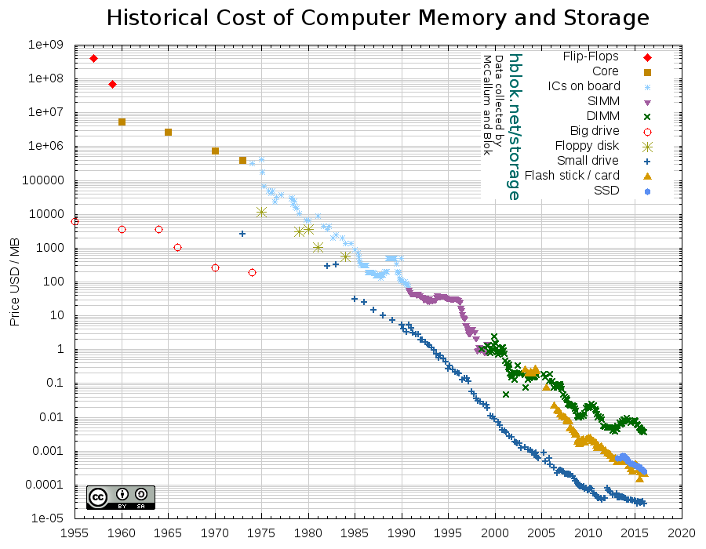
DRAM
Flash
Disk
Notes:
DIMM: Dual in-line Memory Module (which has replaced Single in-line Memory Module SIMM)
Flash stick is better known as a USB drive

Slide 37
Comparing Drive Types
 | HDD | Flash-based SSD
Durability and Noise | Loud and susceptible to shock | No moving parts!
Access Time | ~ 12 ms ≈ 30M clock cycles | ~ 0.1 ms ≈ 250K clock cycles
Relative Power | 1 | 1/3
Cost | ~ $0.017 / GB | ~ $0.099 / GB
Capacity | 500GB - 4TB | 128GB - 500GB
Other Problems | Fragmentation | Limited Writes
Lifespan | 5-10 years | 3-5 years
Ref: CS 61C, Lecture on Input/Output, Branden Ghena, Univ of California, Berkeley

Slide 38
Methods for I/O

Slide 39

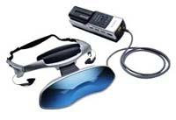
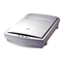


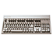
What do we need for I/O to work?
A way to connect many types of devices
A way to control these devices, respond to them, and transfer data
A way to present them to user programs so they are useful
Computer
Proc
Mem
Ref: CS 61C, Lecture on Input/Output, Branden Ghena, Univ of California, Berkeley

Slide 40
Methods for I/O
What must the processor do for I/O?
Input: read a sequence of bytes
Output: write a sequence of bytes
Interface options
Input/output instructions: Some processors have special instructions (example: CISC processors) – We will not study it further
Memory mapped I/O
Portion of address space dedicated to communication paths to input and output devices
Use of normal load/store instructions, e.g. lw/sw
Very common, used by RISC-V
I/O device use registers there (no memory)
Ref: CS 61C, Lecture on Input/Output, Branden Ghena, Univ of California, Berkeley

Slide 41
Memory Mapped I/O
Certain addresses are not regular memory addresses
Instead, they correspond to registers in I/O devices
Loads and stores read/write to the device
Address
0xFFFFFFFF
control reg.
0xFFFF0000
data reg.
0x00000000
Ref: CS 61C, Lecture on Input/Output, Branden Ghena, Univ of California, Berkeley

Slide 42
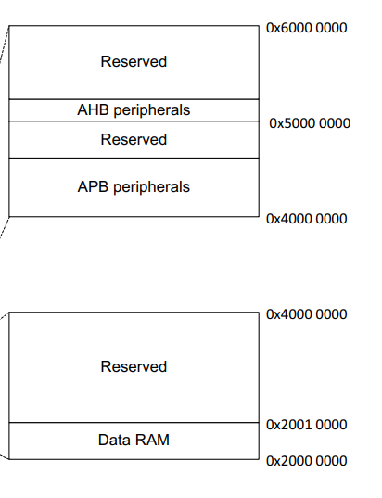
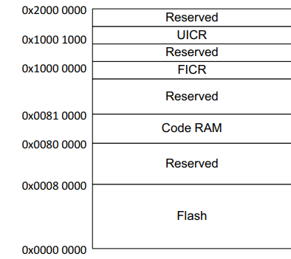
Memory Maps
Example from EE149
(nRF52832 microcontroller)
Flash from 0x0 - 0x800000
RAM at 0x20000000
Memory-mapped peripherals start at 0x40000000
Ref: CS 61C, Lecture on Input/Output, Branden Ghena, Univ of California, Berkeley

Slide 43
Memory Mapped Input Output: Polling

Slide 44
Processor-I/O Speed Mismatch
1 GHz microprocessor can execute 1 billion load or store instructions/sec (32,000,000 Kb/s data rate)
Recall: I/O devices data rates range from less than 1 Kb/s to more than 1,000,000 Kb/s
Input: Device may not be ready to send data as fast as the processor loads it
Also, might be waiting for human to act
Output: Device may not be ready to accept data as fast as processor stores it
Ref: CS 61C, Lecture on Input/Output, Branden Ghena, Univ of California, Berkeley

Slide 45
Processor Checks Status before Acting
Device registers generally serve two functions:
Control Register, says it’s OK to read/write (I/O ready) - Flag
Data Register, contains data
Processor reads from Control Register in loop
Waiting for device to set Ready bit in Control register (0 → 1)
Indicates “data available” or “ready to accept data”
Processor then loads from (input) or writes to (output) data register
I/O device resets control register bit (1 → 0)
Procedure called “Polling”
Ref: CS 61C, Lecture on Input/Output, Branden Ghena, Univ of California, Berkeley

Slide 46
I/O Example (Polling)
Input: Read from keyboard into a0
lui t0,0x7ffff #7ffff000 (io addr) Waitloop: lw t1,0(t0) #read control andi t1,t1,0x1 #ready bit beq t1,zero,Waitloop lw a0,4(t0) #data
Output: Write to display from a1
lui t0,0x7ffff #7ffff0000 Waitloop: lw t1,8(t0) #write control andi t1,t1,0x1 #ready bit beq t1,zero,Waitloop sw a1,12(t0) #data
“Ready” bit is from processor’s point of view!
Ref: CS 61C, Lecture on Input/Output, Branden Ghena, Univ of California, Berkeley

Slide 47
Cost of Polling a Mouse?
Assume for a processor with a 1GHz clock it takes 400 clock cycles for a polling operation (call polling routine, accessing the device, and returning). Determine % of processor time for polling
Mouse: polled 30 times/sec so as not to miss user movement
Mouse Polling [clocks/sec]
= 30 [polls/s] * 400 [clocks/poll] = 12K [clocks/s]
% Processor for polling:
12*10³ [clocks/s] / 1*10⁹ [clocks/s] = 0.0012%
➔ Polling mouse little impact on processor’s performance
Ref: CS 61C, Lecture on Input/Output, Branden Ghena, Univ of California, Berkeley

Slide 48
Cost of Polling a Hard Disk?
Hard disk: transfers data in 16-Byte chunks and can transfer at 16 MB/second. No transfer can be missed
Frequency of Polling Disk
= 16 [MB/s] / 16 [B/poll] = 1M [polls/s]
Disk Polling, Clocks/sec = 1M [polls/s] * 400 [clocks/poll] = 400M [clocks/s]
% Processor for polling:
400*10⁶ [clocks/s] / 1*10⁹ [clocks/s] = 40%
➔ Unacceptable
(Polling is only part of the problem – main problem is that accessing in small chunks is inefficient)
Ref: CS 61C, Lecture on Input/Output, Branden Ghena, Univ of California, Berkeley

Slide 49
Memory Mapped Input Output: Interrupt

Slide 50
What is the Alternative to Polling?
Polling wastes processor resources
Akin to waiting at the door for guests to show up
What about a bell?
Computer lingo for bell: Interrupt
Solution: Use exception mechanism to help trigger I/O, then interrupt program when I/O is done with data transfer
Ref: CS 61C, Lecture on Input/Output, Branden Ghena, Univ of California, Berkeley

Slide 51
Exceptions and Interrupts
“Unexpected” events requiring change in flow of control
Different ISAs use the terms differently
Exception
Arises within the CPU (e.g. undefined opcode, overflow, syscall, TLB Miss)
Segmentation fault – core dumped
Interrupt
From an external I/O controller
Caused by an event external to current running program
Example: Key Press, Disk I/O
Dealing with these without sacrificing performance is difficult!
Ref: CS 61C, Lecture on Input/Output, Branden Ghena, Univ of California, Berkeley

Slide 52
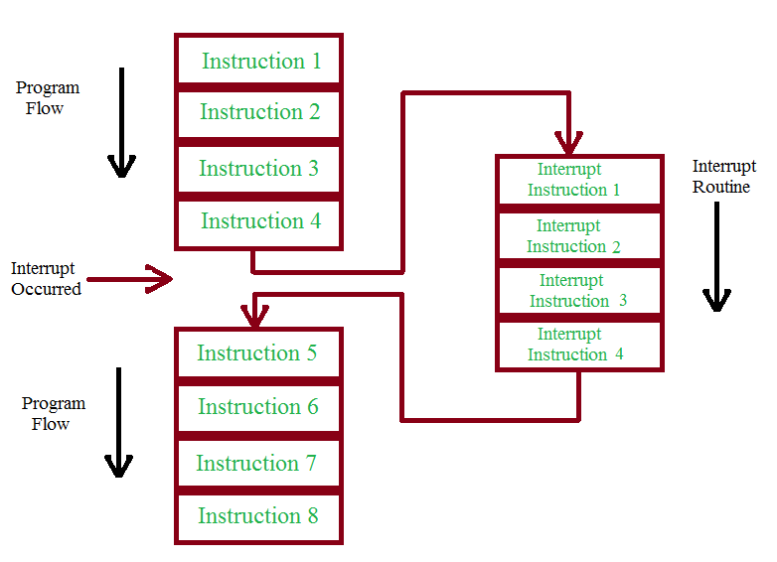
Interrupting the Processor
Ref: CS 61C, Lecture on Input/Output, Branden Ghena, Univ of California, Berkeley

Slide 53
Exception/Interrupt Steps
External event occurs
Save the PC and registers!
Change PC to exception/interrupt handler
Execute handler code
Restore registers and PC

Slide 54
Exceptions in a Pipeline
Another kind of control hazard
Consider overflow on fadd.s in EX stage
fadd.s x1, x2, x1
Prevent x1 from being clobbered
Complete previous instructions
Flush fadd and subsequent instructions
Save PC and registers
Transfer control to handler
Similar to mis-predicted branch
Use much of the same hardware

Slide 55
I/O Interrupt
An I/O interrupt is like an exception except:
An I/O interrupt is “asynchronous”
More information needs to be conveyed
“Asynchronous” with respect to instruction execution:
I/O interrupt is not associated with any instruction, but it can happen in the middle of any given instruction
I/O interrupt does not prevent any instruction from running to completion
Ref: Krste Asanović & Randy H. Katz, Univ of California, Berkeley
Notes:
How does an I/O interrupt different from the exception you already learned?
Well, an I/O interrupt is asynchronous with respect to the instruction execution while exception such as overflow or page fault are always associated with a certain instruction.
Also for exception, the only information needs to be conveyed is the fact that an exceptional condition has occurred but for interrupt, there is more information to be conveyed.
Let me elaborate on each of these two points.
Unlike exception, which is always associated with an instruction, interrupt is not associated with any instruction. The user program is just doing its things when an I/O interrupt occurs.
So I/O interrupt does not prevent any instruction from completing so you can pick your own convenient point to take the interrupt.
As far as conveying more information is concerned, the interrupt detection hardware must somehow let the OS know who is causing the interrupt.
Furthermore, interrupt requests needs to be prioritized. The hardware that can do all these looks like this.

Slide 56
Interrupt-Driven Data Transfer
Memory
(1) I/O
interrupt
add
sub
and
or
user
program
(2) save PC
(3) jump to interrupt
service routine
(5)
read
store
...
jr
interrupt
service
routine
(4) perform transfer
Ref: CS 61C, Lecture on Input/Output, Branden Ghena, Univ of California, Berkeley
Notes:
That is, whenever an I/O device needs attention from the processor, it interrupts the processor from what it is currently doing.
This is how an I/O interrupt looks in the overall scheme of things. The processor is minding its business when one of the I/O device wants its attention and causes an I/O interrupt.
The processor then save the current PC, branch to the address where the interrupt service routine resides, and start executing the interrupt service routine.
When it finishes executing the interrupt service routine, it branches back to the point of the original program where we stop and continue.
The advantage of this approach is efficiency. The user program’s progress is halted only during actual transfer.
The disadvantage is that it require special hardware in the I/O device to generate the interrupt. And on the processor side, we need special hardware to detect the interrupt and then to save the proper states so we can resume after the interrupt.
+2 = 62 min. (Y:42)

Slide 57
Interrupt-Driven I/O Example (1/2)
Assume the following system properties:
500 clock cycle overhead for each transfer, including interrupt
Disk throughput of 16 MB/s
Disk interrupts after transferring 16 B
Processor running at 1 GHz
If disk is active 5% of program, what % of processor is consumed by the disk?
5% × 16 [MB/s] / 16 [B/inter] = 50,000 [inter/s]
50,000 [inter/s] × 500 [clocks/inter] = 2.5×10⁷ [clocks/s]
2.5×10⁷ [clocks/s] / 10⁹ [clock/s] = 2.5% busy
Ref: CS 61C, Lecture on Input/Output, Branden Ghena, Univ of California, Berkeley

Slide 58
Interrupt-Driven I/O Example (2/2)
2.5% busy (interrupts) much better than 40% (polling) but still not good enough…
Especially if I have multiple devices
Ref: CS 61C, Lecture on Input/Output, Branden Ghena, Univ of California, Berkeley

Slide 59
Lecture Summary
I/O devices are very important part of any consumer system/Computing platform
I/O devices operate
at varying degree of bandwidth
At different timing requirements (non real-time or real-time)
ISA may provide instructions for I/O with external devices
Not much in use
Memory Mapped I/O (commonly used). Approaches include
Polling
Interrupt
DMA (In the next class)

